Slide 1
Community 2.0
The new decision making platform

Slide 2
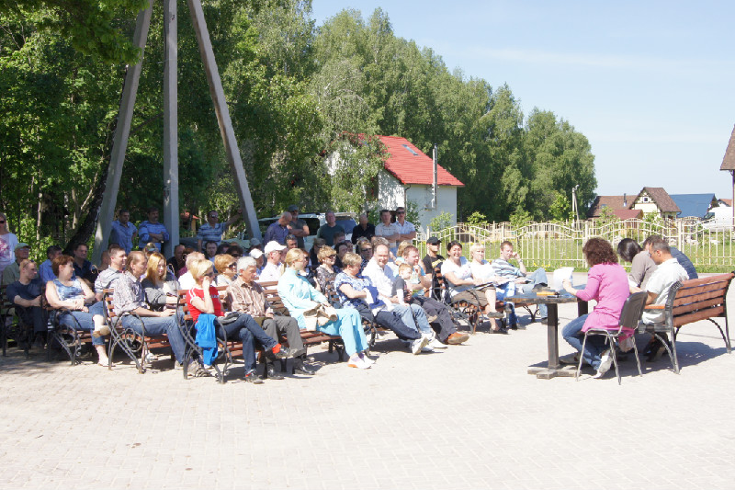
General meeting and productive communication

Slide 3
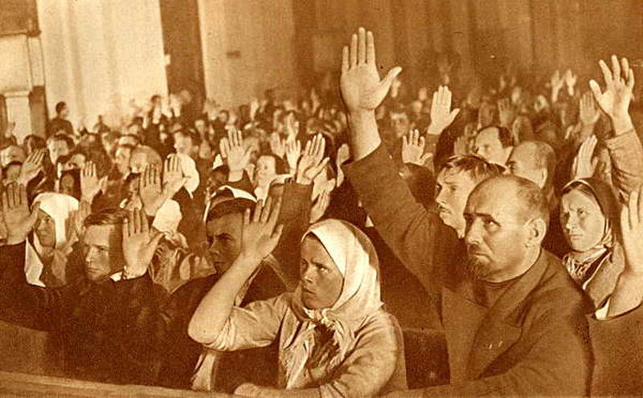
General meeting and productive communication

Slide 4
The problems:
It is impossible to collect everyone on the meeting
No discussion – those who shout louder are the right ones
Little control for chairperson and the decision making group
Bad moderator can change what he doesn’t like

Slide 5
Meritocratic decision making system
Announcing the problem and collecting the ways to solve it
Voting for the way we gonna solve it
The more you contribute to the society – the more weight your voice has
You can delegate your voice to the person you trust
Everything is locked in blockchain – no way to cheat

Slide 6
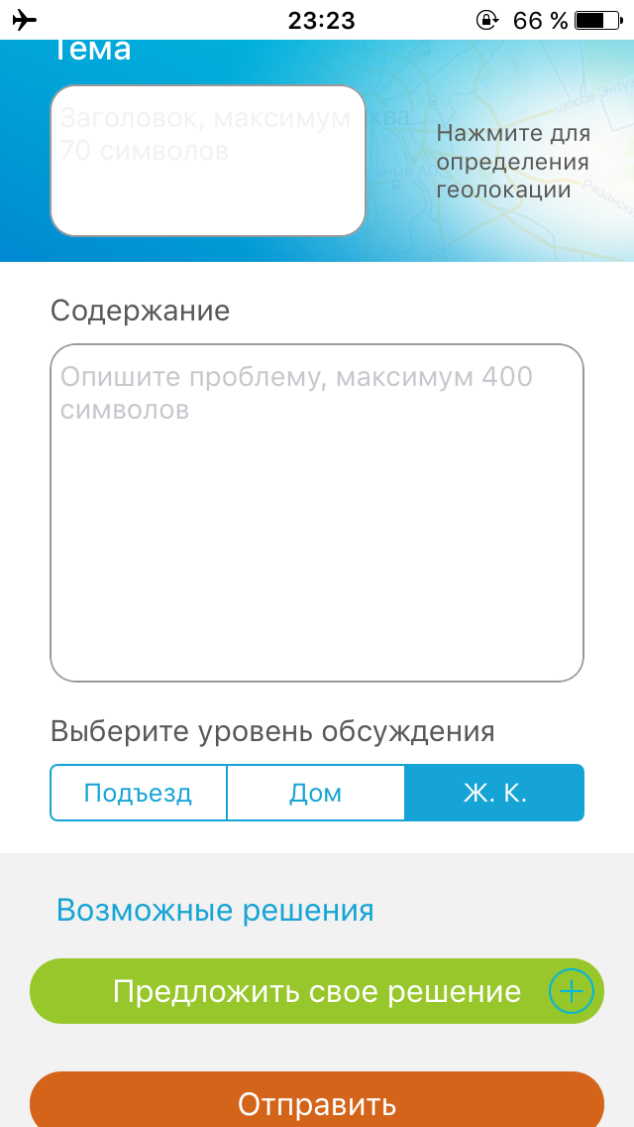
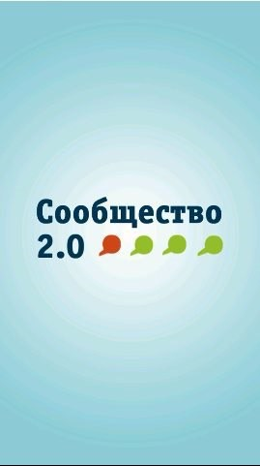
What we have

Slide 7
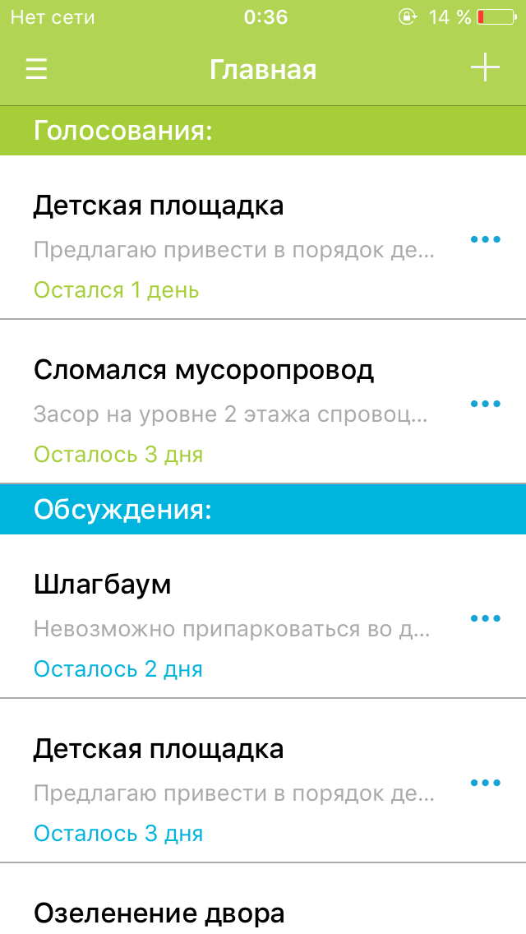
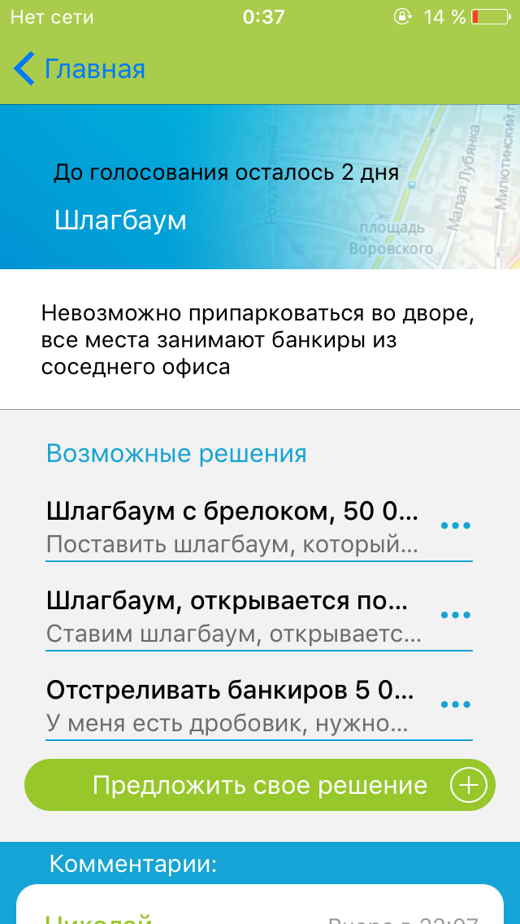

Slide 8
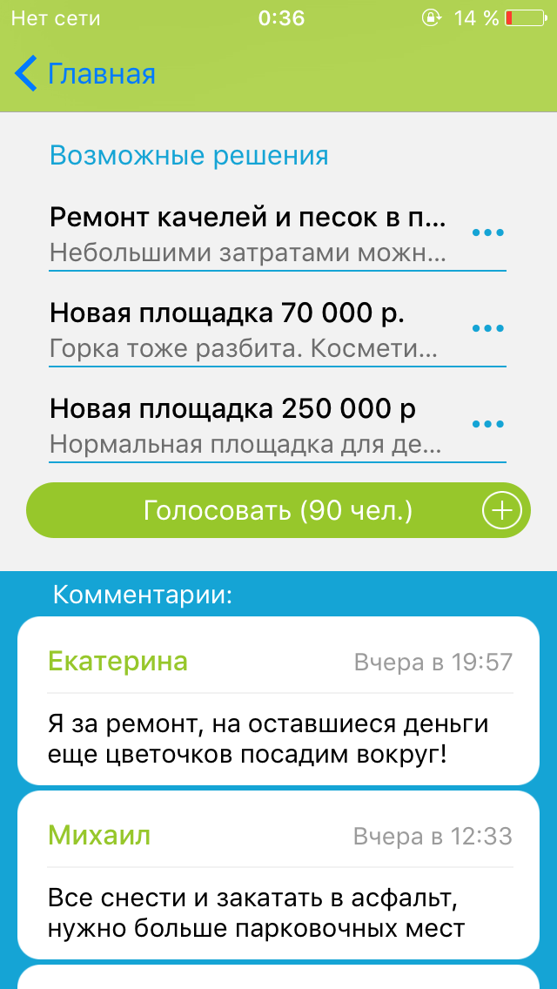
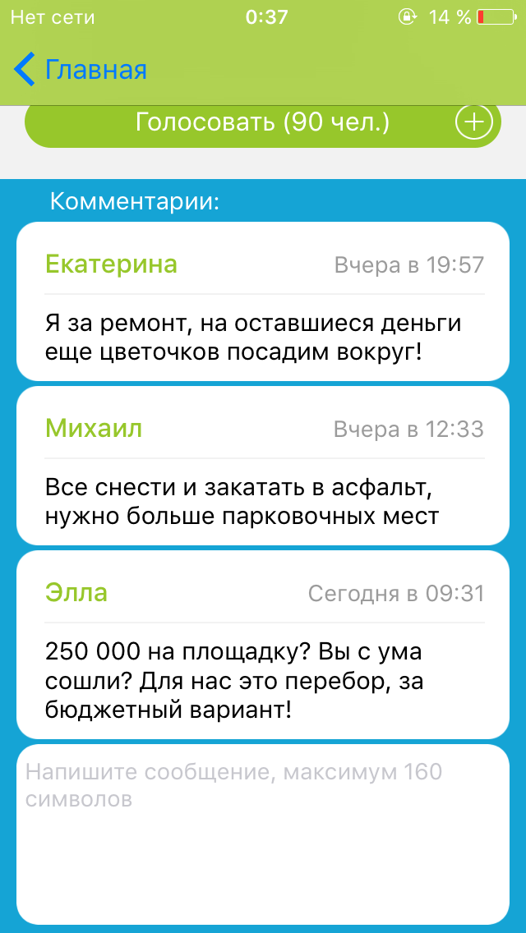

Slide 9
Our plans
Finish the integration with the app and telegram
Implement text to voice bot for grannies (not internet/mobile users)
Test platform in my settlement, get feedback from friendly neighbors
Partnership with developer companies
Global platform for referendums and voting

Slide 10
Community 2.0
The second place will be OK ☺
https://github.com/Dimography/soobshestvo_2.0

